Slide 1
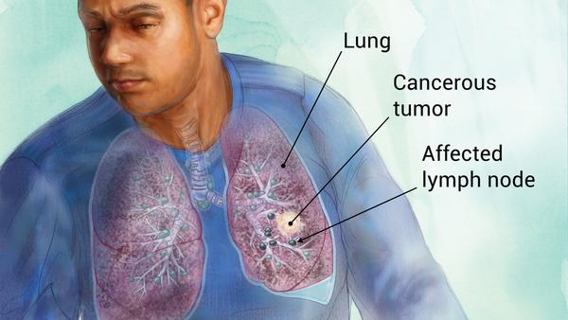
Lung Cancer Detection & stages Identification using CNN algorithm

Slide 2
Abstract
Image processing techniques are now commonly used in the medical field for early detection of diseases.
This research aims to improve accuracy, sensitivity and specificity of early detection of lung cancer through a combination of image processing techniques and data mining.
The Computed Tomography (CT) scan image of the lungs is pre-processed and the Region of Interest (ROI) segmented.
In this project we are using CNN algorithm to detect Lung cancer from CT-SCAN images and to train CNN. We have CT-SCAN images dataset.
Few images from ABNORMAL folder and we used above images to train CNN algorithm and after training CNN we can upload test images and then CNN will predict whether CT_SCAN contains normal or abnormal tumour

Slide 3
LUNG CANCER
A cancer that begins in the lungs and most often occurs in people who smoke.
Two major types of lung cancer are non-small cell lung cancer and small cell lung cancer.
Causes of lung cancer include smoking, second-hand smoke, exposure to certain toxins and family history.
Symptoms include a cough (often with blood), chest pain, wheezing and weight loss.
These symptoms often don't appear until the cancer is advanced. Treatments vary but may include surgery, chemotherapy, radiation therapy, targeted drug therapy and immunotherapy.

Slide 4
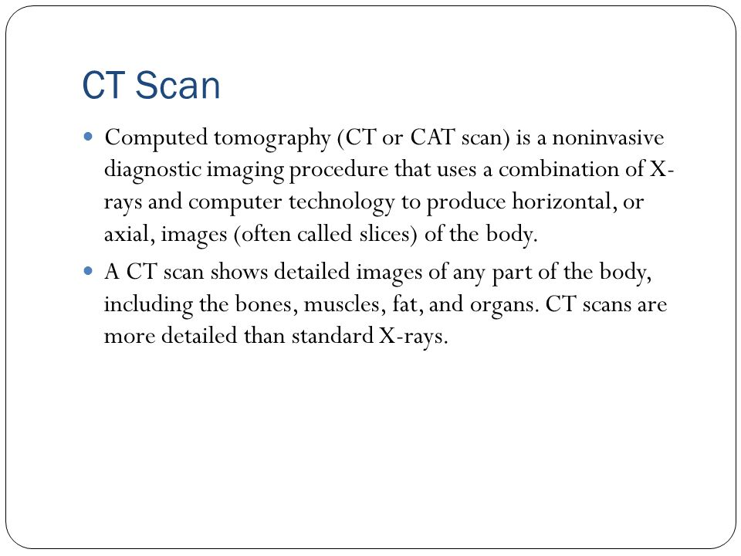

Slide 5
Existing Algorithms
Existing algorithms used for segmentation are
Watershed algorithm
K-means Clustering
Gray level thresholding
Region growing
Fuzzy c-means clustering
Such existing techniques are very complex and having very high run time complexity..

Slide 6
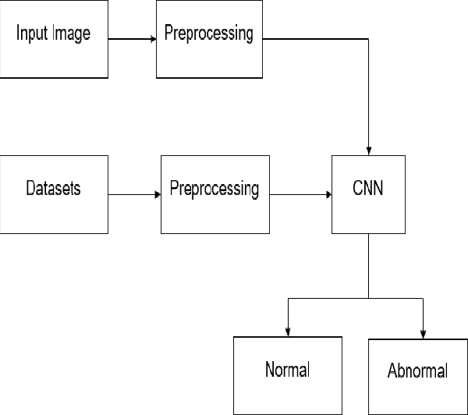
Proposed Method
Stage 1
Stage 2
Stage 3

Slide 7
CNN (Convolutional Neural Network)
Our proposed lung parenchyma segmentation method consists of three stages:
(1) the generation of the labeled dataset to be fed into the CNN;
(2) the design, training and validation of a CNN model;
(3) the segmentation using the trained CNN.
CNN architectures have two primary types: segmentations CNNs that identify regions in an image from one or more classes of semantically interpretable objects, and classification CNNs that classify each pixel into one or more classes given a set of Normal/Abnormal category.

Slide 8
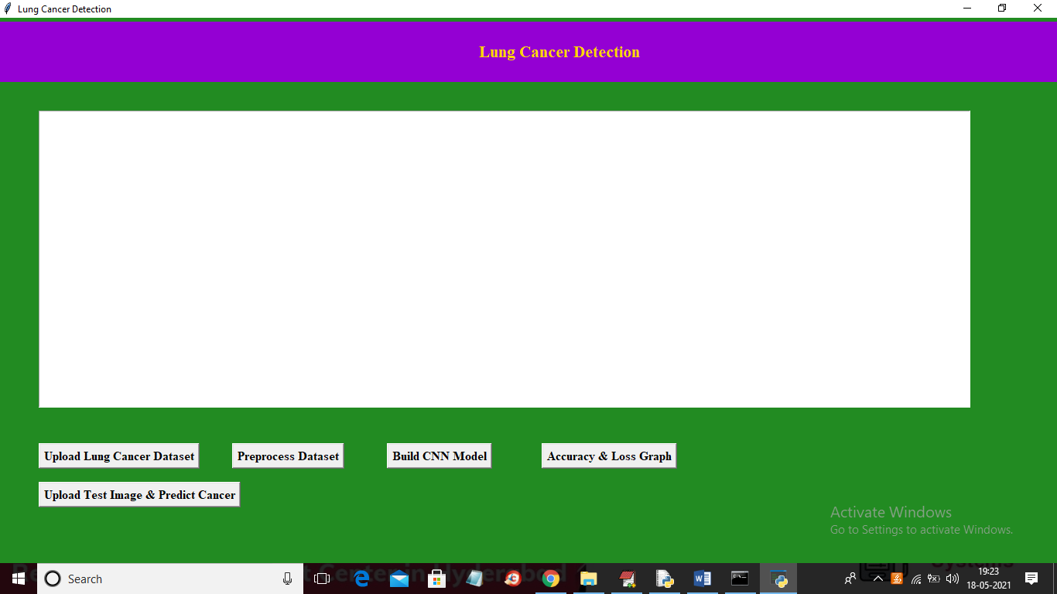
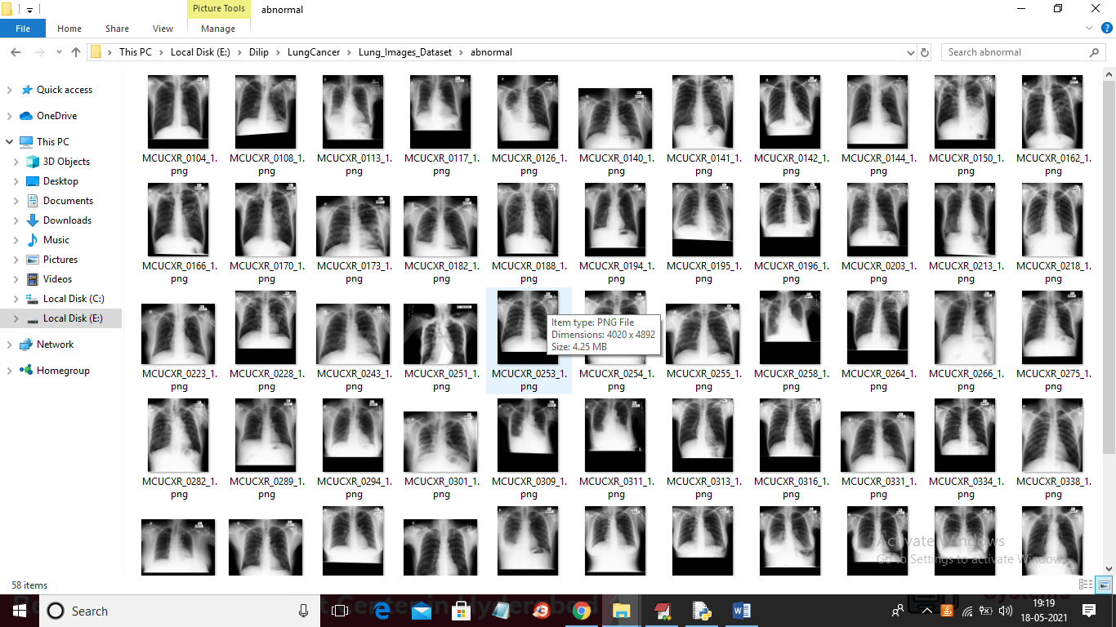
Results
Fig. a ) Sample user Interface b) Lung CT Image dataset

Slide 9
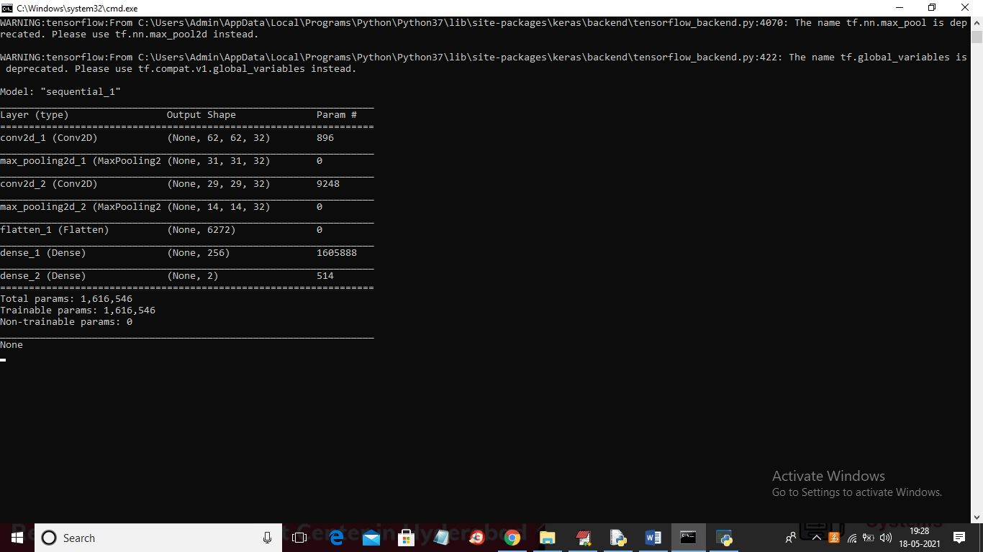
CNN architecture used

Slide 10
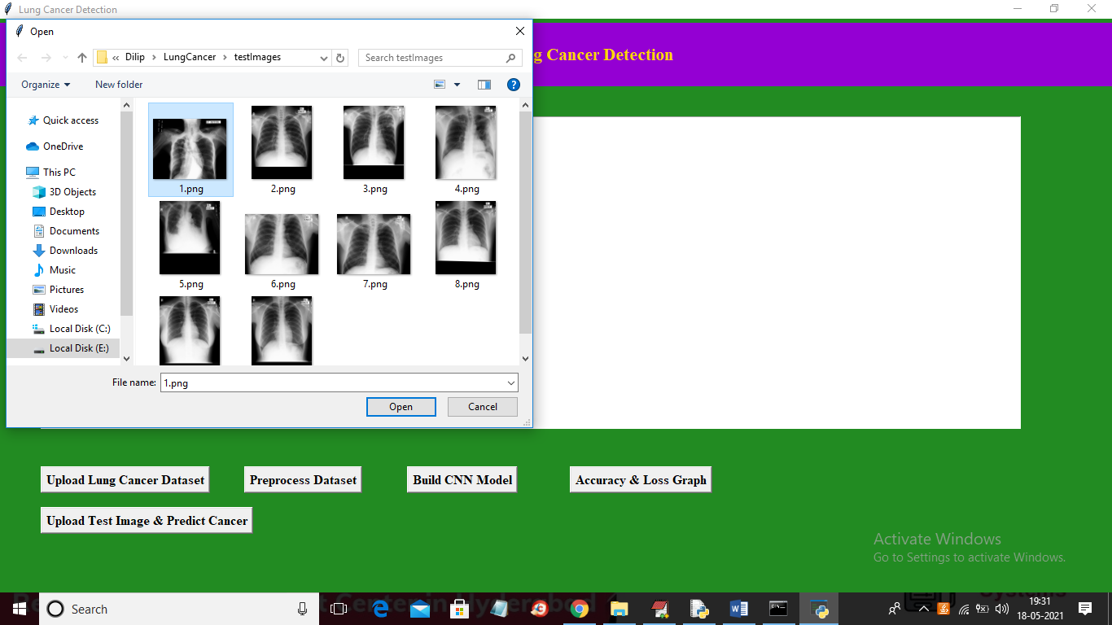
Loaded Sample Image from Dataset for testing

Slide 11
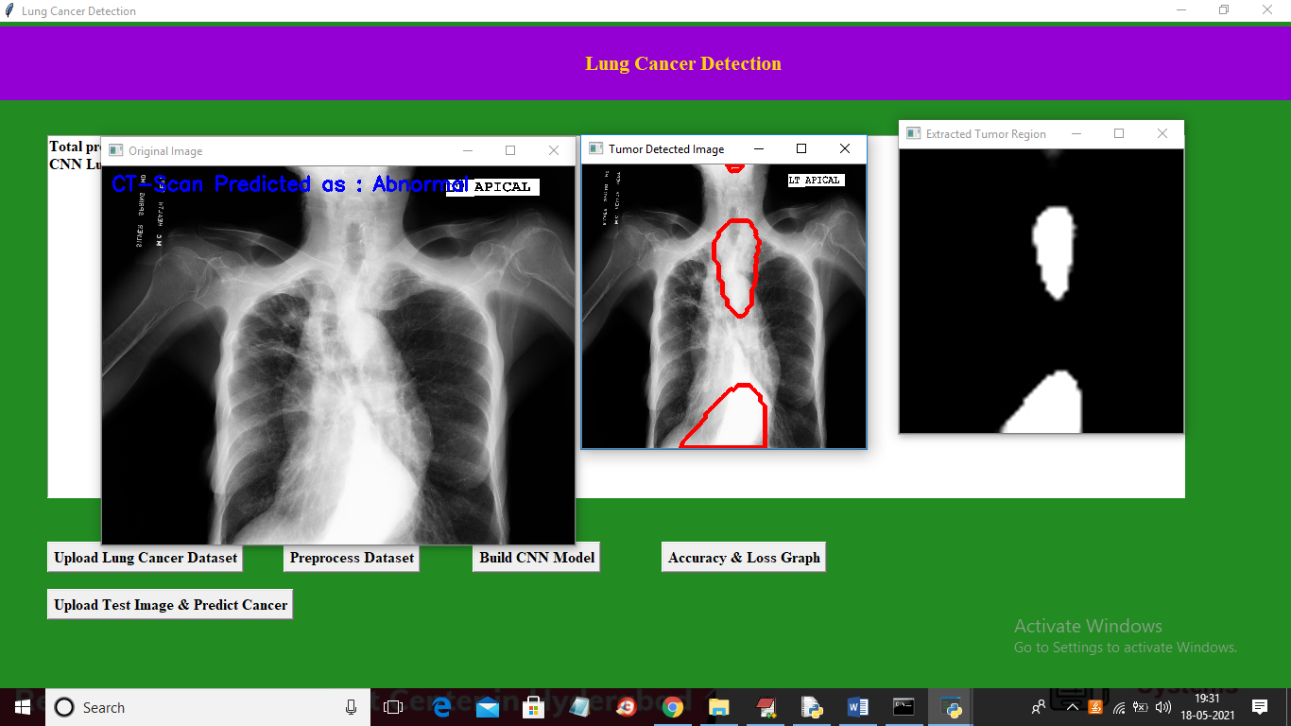
Detected Final Results
Fig. a) detected Normal/Abnormal b) Detected Region c) Extracted Tumor region

Slide 12
Conclusion
In this paper, a system for automatic detection of lung cancer in CT images was successfully developed using image processing technique.
Hence this proposed methodology helps in accurate and early stage detection of lung cancer.
In this project we are using CNN algorithm to detect Lung cancer from CT-SCAN images and to train CNN. We have CT-SCAN images dataset.
Few images from ABNORMAL/NORMAL folder and we used above images to train CNN algorithm and after training CNN we can upload test images and then CNN will predict whether CT_SCAN contains normal or abnormal tumour

Slide 13
References
[1] Cheran, S.C and G. Gargano, 2005. Computer aided diagnosis for lung CT using artificial life models. Proceeding of the 7th International Symposium onSymbolic and Numeric Algorithms for ScientificComputing, Sep 25-29, IEEE Computer Society,Romania, pp: 329-332. ISBN: 0-7695-2453-2El-Baz, A., G. Gimel'farb, R. Falk and M.A.
[2] El-Ghar,2007. A new CAD system for early diagnosis ofdetected lung nodules. Proceeding of the IEEE International Conference on Image Processing, Sep16-Oct 19, San Antonio, TX., pp: 461-464. ISSN:1522-4880
[3] Fiebich, M., D. Wormanns and W. Heindel, 2001.Improvement of method for computer-assisted detection of pulmonary nodules in CT of the chest.Proc. SPIE Med. Image. Conf., 4322: 702-709.DOI: 10.1117/12.431147
[4]Ginneken, B.V., B.M. Romeny and M.A. Viergever,2001. Computer-aided diagnosis in chestradiography: A survey. IEEE, Tran. Med. Image.,20: 1228-1241. ISSN: 0278-0062
[5] Gomathi, M. and P. Thangaraj, 2010. A new approachto lung image segmentation using fuzzypossibilistic C-means algorithm. Int. J. Comput.Sci. Inf. Sec., 7: 222-228. ISSN: 1947 5500
[6] Gurcan, M.N., B. Sahiner, N. Petrick, H. Chan andE.A. Kazerooni, et al., 2002. Lung noduledetection on thoracic computed tomographyimages: Preliminary evaluation of a computeraided diagnosis system. Med. Phys., 29: 2552-2558.
[7] http://www.ncbi.nlm.nih.gov/pubmed/12462722

Slide 14


